Slide 1
Introduction to the Advanced Therapies Apprenticeship Community (ATAC)

Slide 2
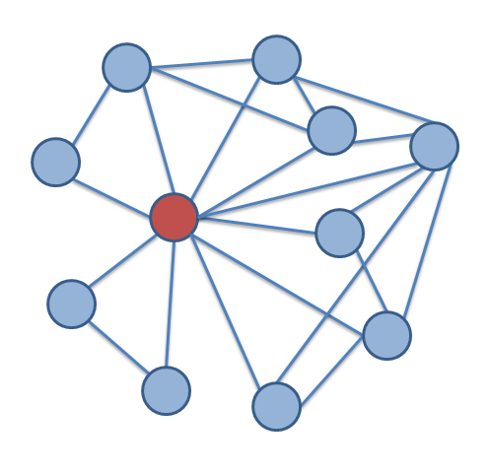
Employer
80% of your time spent ON the job
Approx. 20% OFF the job learning
Use resources and projects at work to reinforce your learning
Work- based projects
Technical Knowledge
Where does ATAC fit in?
Management
Skills
Leadership Behaviours
Employer
Training Provider
ATAC Cohort
Open University
ATAC Industry Cohort
Academic modules
TMA/EMA
Webinars
Tutorials
Work-based projects
Residentials
Compliment learning
Useful resources
MBA network
Sector experience
Regulatory Knowledge
Industry Knowledge
Specific
Skills
Business Skills
Industry Training
Professional Network

Slide 3
Who does ATAC support?
APPRENTICE
Complimentary learning activities
Company site visits aligned to modules
Industry webinars with business leaders
Networking events across sector
Professional Network
Wider industry knowledge across industry
Group experience, learning from each other
Website with useful resources
ATAC support on top of training provider & employer
EMPLOYER
Support with recruitment and on-boarding
Advert templates & generic job descriptions
Promotion & advertising roles
Assessment days & interviews
Support for line managers
F2F visits, on-boarding & training plans
Check lists, webinars and contacts
Local networking events to share best practise
Website of useful resources and case studies
ATMP Industry
Meeting skills demand for sector based on evidence
Embedding apprenticeships - route to bring in new talent
Customising apprenticeships with selected training providers
Developing new standards across UK to ensure sector success
Upskilling existing staff in key technical and managerial areas
Building dedicated cohorts to ensure employer needs are met
Model for other nascent sectors

Slide 4
How can ATAC support you?
As an individual leader ?
As a cohort ?
As a company ?
e.g. Access to useful resources ?
e.g. Supervisor webinars ?
e.g. 6 monthly networking event ?
Next steps - * Highlight top 3

Slide 5
Would a mentor be useful?
Mentors play a spectrum of roles in supporting successful leaders, often wearing different hats within the same relationship – the best mentors use a wide range of responses to support their mentee. Mentors can be critical to success of a leader and offers you a window in to the wisdom and knowledge of the industry
Sounding Board
Someone independent and uninvolved who can give honest feedback on how the mentee plans to tackle an issue using the accumulated experience from across industry
Critical Friend
Someone willing and able to say openly the things that you are reluctant to expose providing a source of challenge, probing beneath the surface and prompting honest discussion
Listener
Being there regularly to encourage and provide a listening ear for as you learn senior leadership, particularly as there is an expectation on you to be successful
Counsellor
An empathetic listener, with reflective and questioning skills to help the mentee analyse problems and opportunities exploring how their emotional drivers affect their rational decision making
Career Advisor
Helping you across the 2 ½ year programme think through career options, plan personal development towards defined career goals using knowledge of the ATMP industry
Networker / Facilitator
Provide access to networks and key links for experience that you will find useful along their programme for both career and development terms helping you build your own networks
Using coaching skills, mentors understand how to make personal change happen, especially at the behavioural level, using an approach led by the mentee.
At the start: Establish the mentees learning objectives, ground rules for the relationship and logistics, be realistic and committed

Slide 6
Think through what you want – we will support you?
Step 1: Why would I want a mentor?
What could a mentor offer me through this apprenticeship?
What sort of mentor would I be looking for?
Really challenge yourself, why are you doing this programme?
Step 2: What do I want to achieve?
Create some SMART objectives for your mentoring relationships
Establish some ground rules for what will work for you – be explicit
Clarify the logistics – how often, when?
Step 3: How do I make it happen?
We have a wide network and can help you look for suitable mentors
You are responsible for making the mentor relationship happen
Be realistic and committed, your mentor has the experience you need
Step 4: How will measure success?
Review your objectives regularly and keep your plan up to date
Ask for honest and challenging feedback to stretch yourself
Keep an open mind and reward yourself
Using coaching skills your mentor will try to understand you and your objectives to make personal change happen using an approach led by YOU.
Can you help: Can you think of any mentors within your company to support others?

